Slide 1

Image Forgery Detection
This presentation explores the concept of image forgery detection using advanced deep learning techniques. The goal is to identify manipulated images, ensuring the authenticity of visual information.
By Kspsvln Siddardha Kumar Kavuri and Modagampalli Mani Datt

Slide 2

Model Architecture
Convolutional layers extract features from images using filters. These filters identify patterns like edges, shapes, and textures. Multiple layers are stacked, progressively extracting more complex features.
Pooling layers downsample feature maps, reducing dimensionality. They discard less important information while preserving key features. Common techniques include max and average pooling.
After feature extraction, a Support Vector Machine (SVM) classifier categorizes images. SVMs find an optimal hyperplane to separate data points into classes. The SVM learns to distinguish between authentic and forged images based on the extracted features.

Slide 3
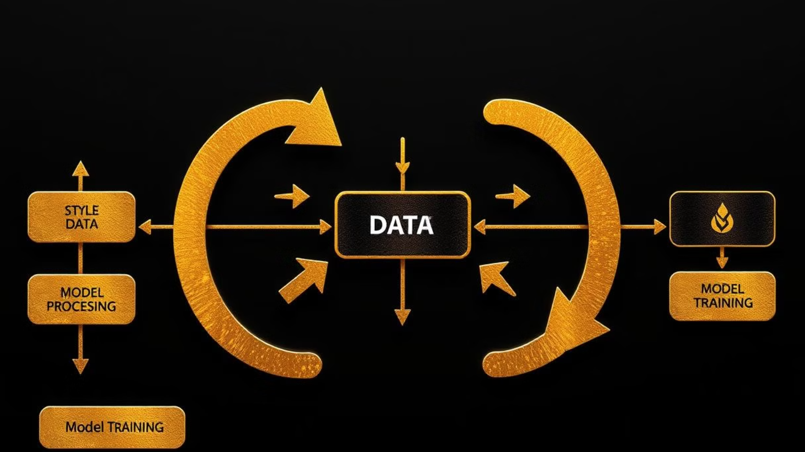
Model Components
1
Patch Extraction
2
Feature Extraction
The input images are resized, normalized, and converted to a suitable format for the model.
The convolutional layers analyze the image, identifying key features and patterns.
3
Classification
4
Post-processing
The model classifies the input image as either authentic or forged based on the extracted features.
The model's output is interpreted and presented in a way that is understandable to humans.

Slide 4

Model Training
1
Dataset Preparation
A large and diverse dataset of authentic and forged images is collected and labeled.
2
Model Initialization
The model's parameters are initialized, setting the stage for learning.
3
Backpropagation
The model's predictions are compared to the true labels, and errors are used to update the model's parameters.
4
Evaluation
The trained model's performance is assessed on a separate validation dataset.

Slide 5

Model Testing
Metric
Value
CNN Accuracy
85%
SVM accuracy
92%

Slide 6
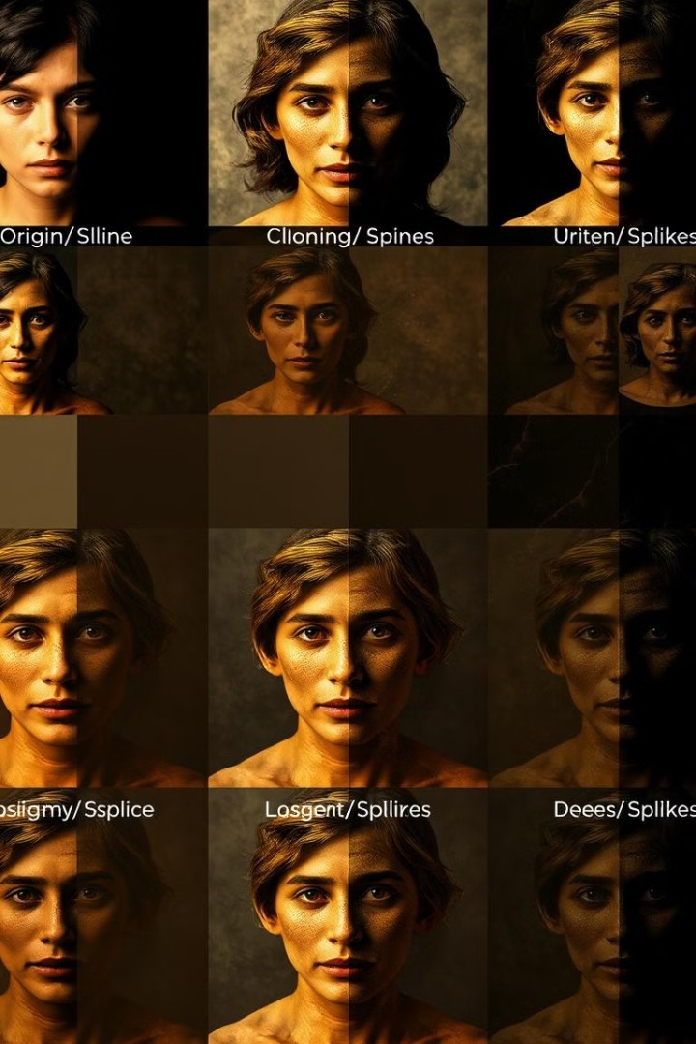





Test Case Execution
Input Image
A test image is provided as input to the model.
Patch Extraction
The model extracts patches from the input image of 128×128×3.
Feature Extraction
The model outputs extracted features from input image.
Classification
Based on features extracted a trained svm model classifies the image.
Output
The model produces a probability score representing the likelihood of the image being forged.

Slide 7
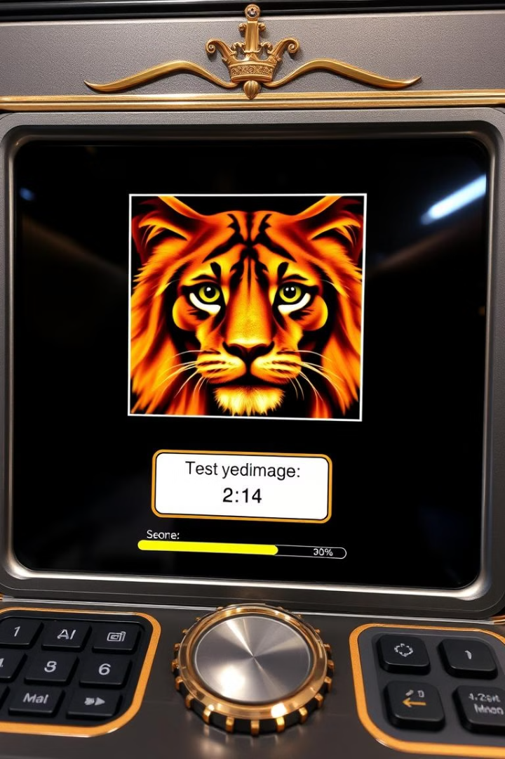


Model Output
Authentic Image
Forged Image
If the model predicts that the image is authentic, the output will indicate "Authentic" with a high confidence score.
If the model identifies the image as forged, the output will indicate "Forged" with a high confidence score.

Slide 8

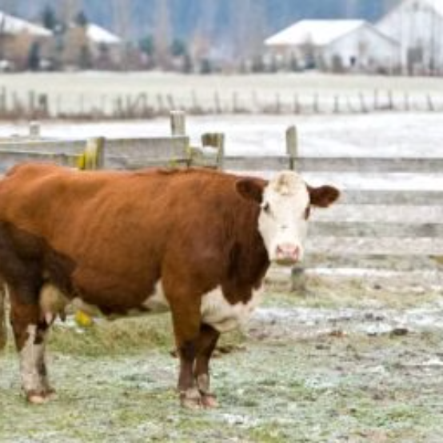


Authentic Images Classified by machine

Slide 9



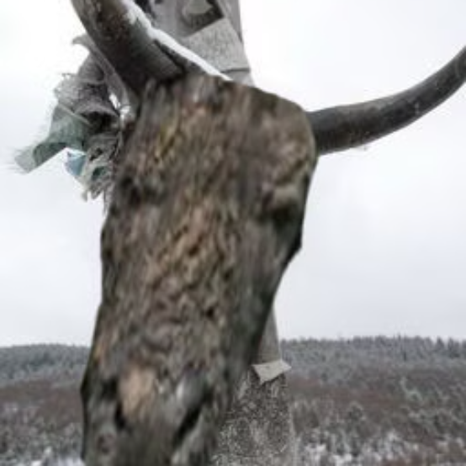
Tampered Images Identified by Machine

Slide 10
Conclusion
Image forgery detection using deep learning models offers a powerful solution for identifying manipulated images. This technology plays a crucial role in maintaining the integrity of visual information in various domains.
The model architecture, training process, and testing results demonstrate the effectiveness of deep learning in this field. The model's ability to classify authentic and forged images with high accuracy showcases its potential to address the increasing challenges of image manipulation.
This technology has far-reaching implications for various industries, including law enforcement, media, and social platforms. By leveraging deep learning, we can contribute to a more trustworthy and reliable digital environment.

